Slide 1



Probing the Structure and Dynamics of Ammonium Formate Using Microwave Spectroscopy
By Kristen Roehling
Mentors: Dr. Stephen Kukolich, Dr. Adam Daly
University of Arizona
Arizona Space Grant Consortium, Hilton Tucson East, April 23, 2022

Slide 2
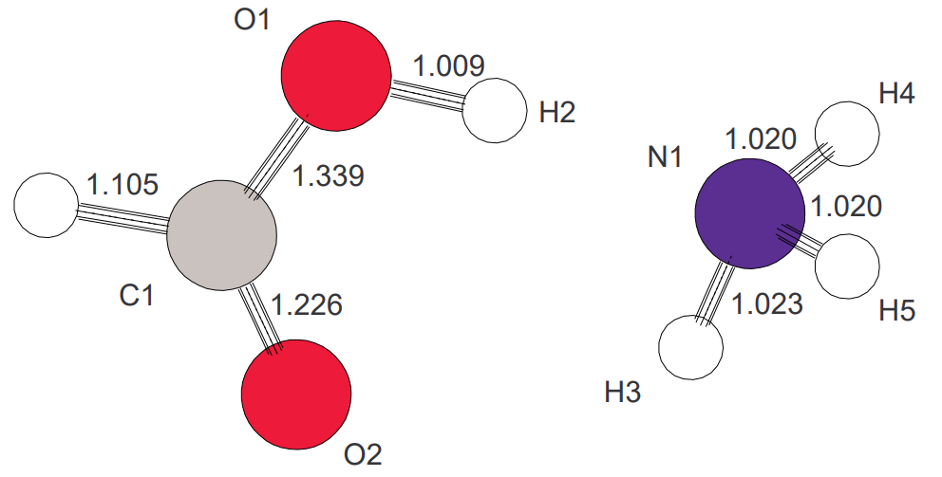
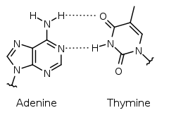
Introduction
Microwave spectroscopy allows the analysis of the structure and dynamics of molecules in the gas phase
Studying ammonium formate provides useful information about the base pair in DNA of adenine and thymine
Useful to also study deuterated (heavy hydrogen) sample
Asymmetric form of ammonium formate, created using RPluto
Source: Wikipedia
Source: Wikipedia

Slide 3
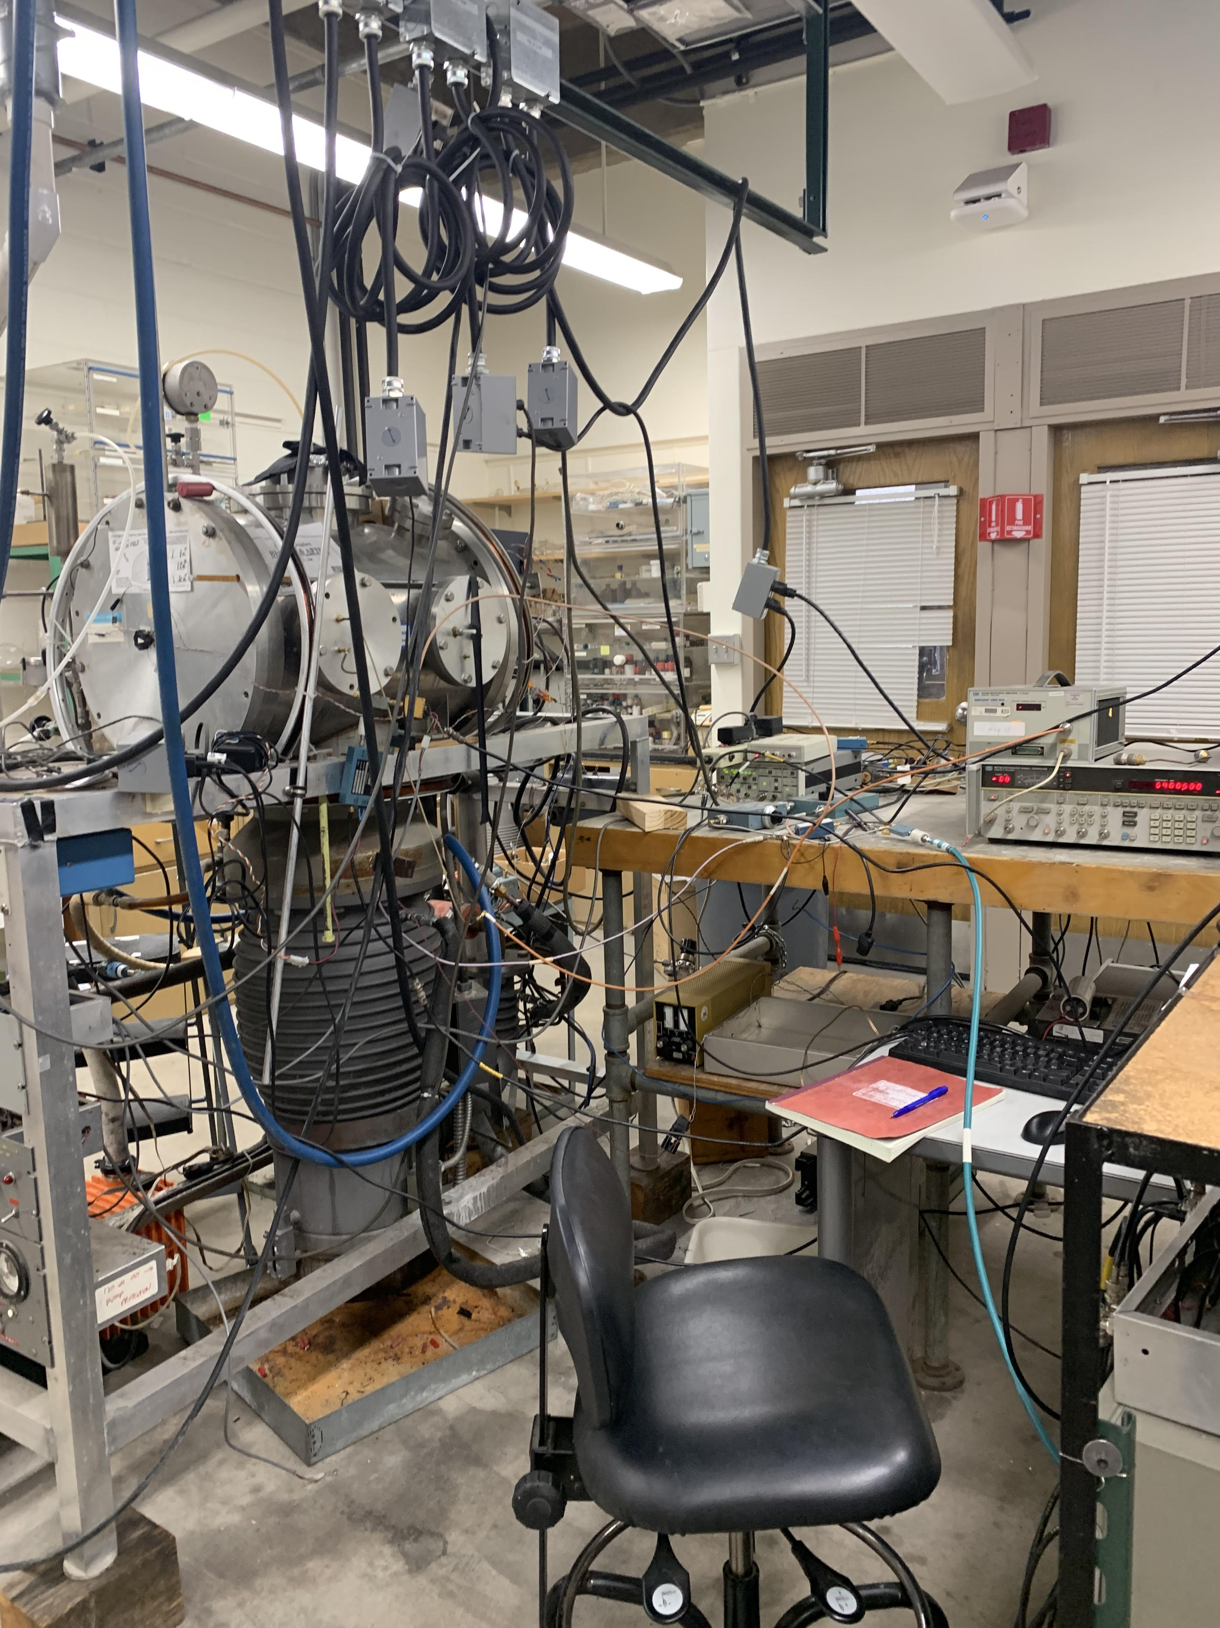
Methods
Optimize theoretical structure using a variety of methods and basis sets
Use optimal structure to predict energy transitions in our frequency range – the microwave spectrum
Scan near these predicted energy levels to find lines
Create a fit with the lines found, and continue to find lines to converge the calculated structure to the experimental findings
Repeat with a fully deuterated sample
Image of spectrometer #1

Slide 4
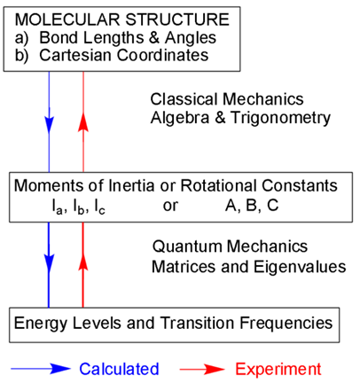
Source: Kukolich Group

Slide 5
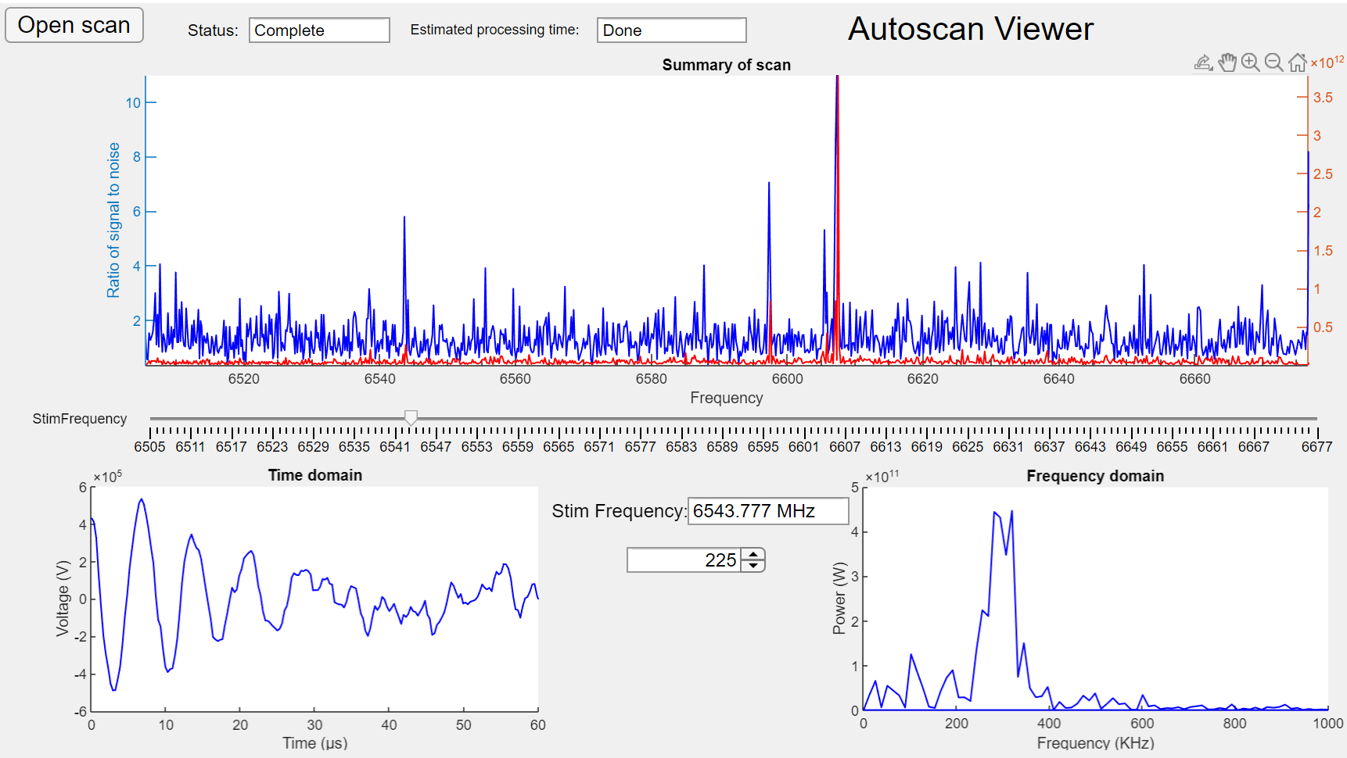

Slide 6
Comparing Predictions and Experimental
Method/Basis set | Predicted 0 → 1 (B + C)
B3LYP 6-311++G** | 7504.80 MHz
DFT wB97XD 6-31G* | 7994.94 MHz
DFT MO6 6-31++G** | 7774.16 MHz
Experimental: 7564.3984 MHz

Slide 7
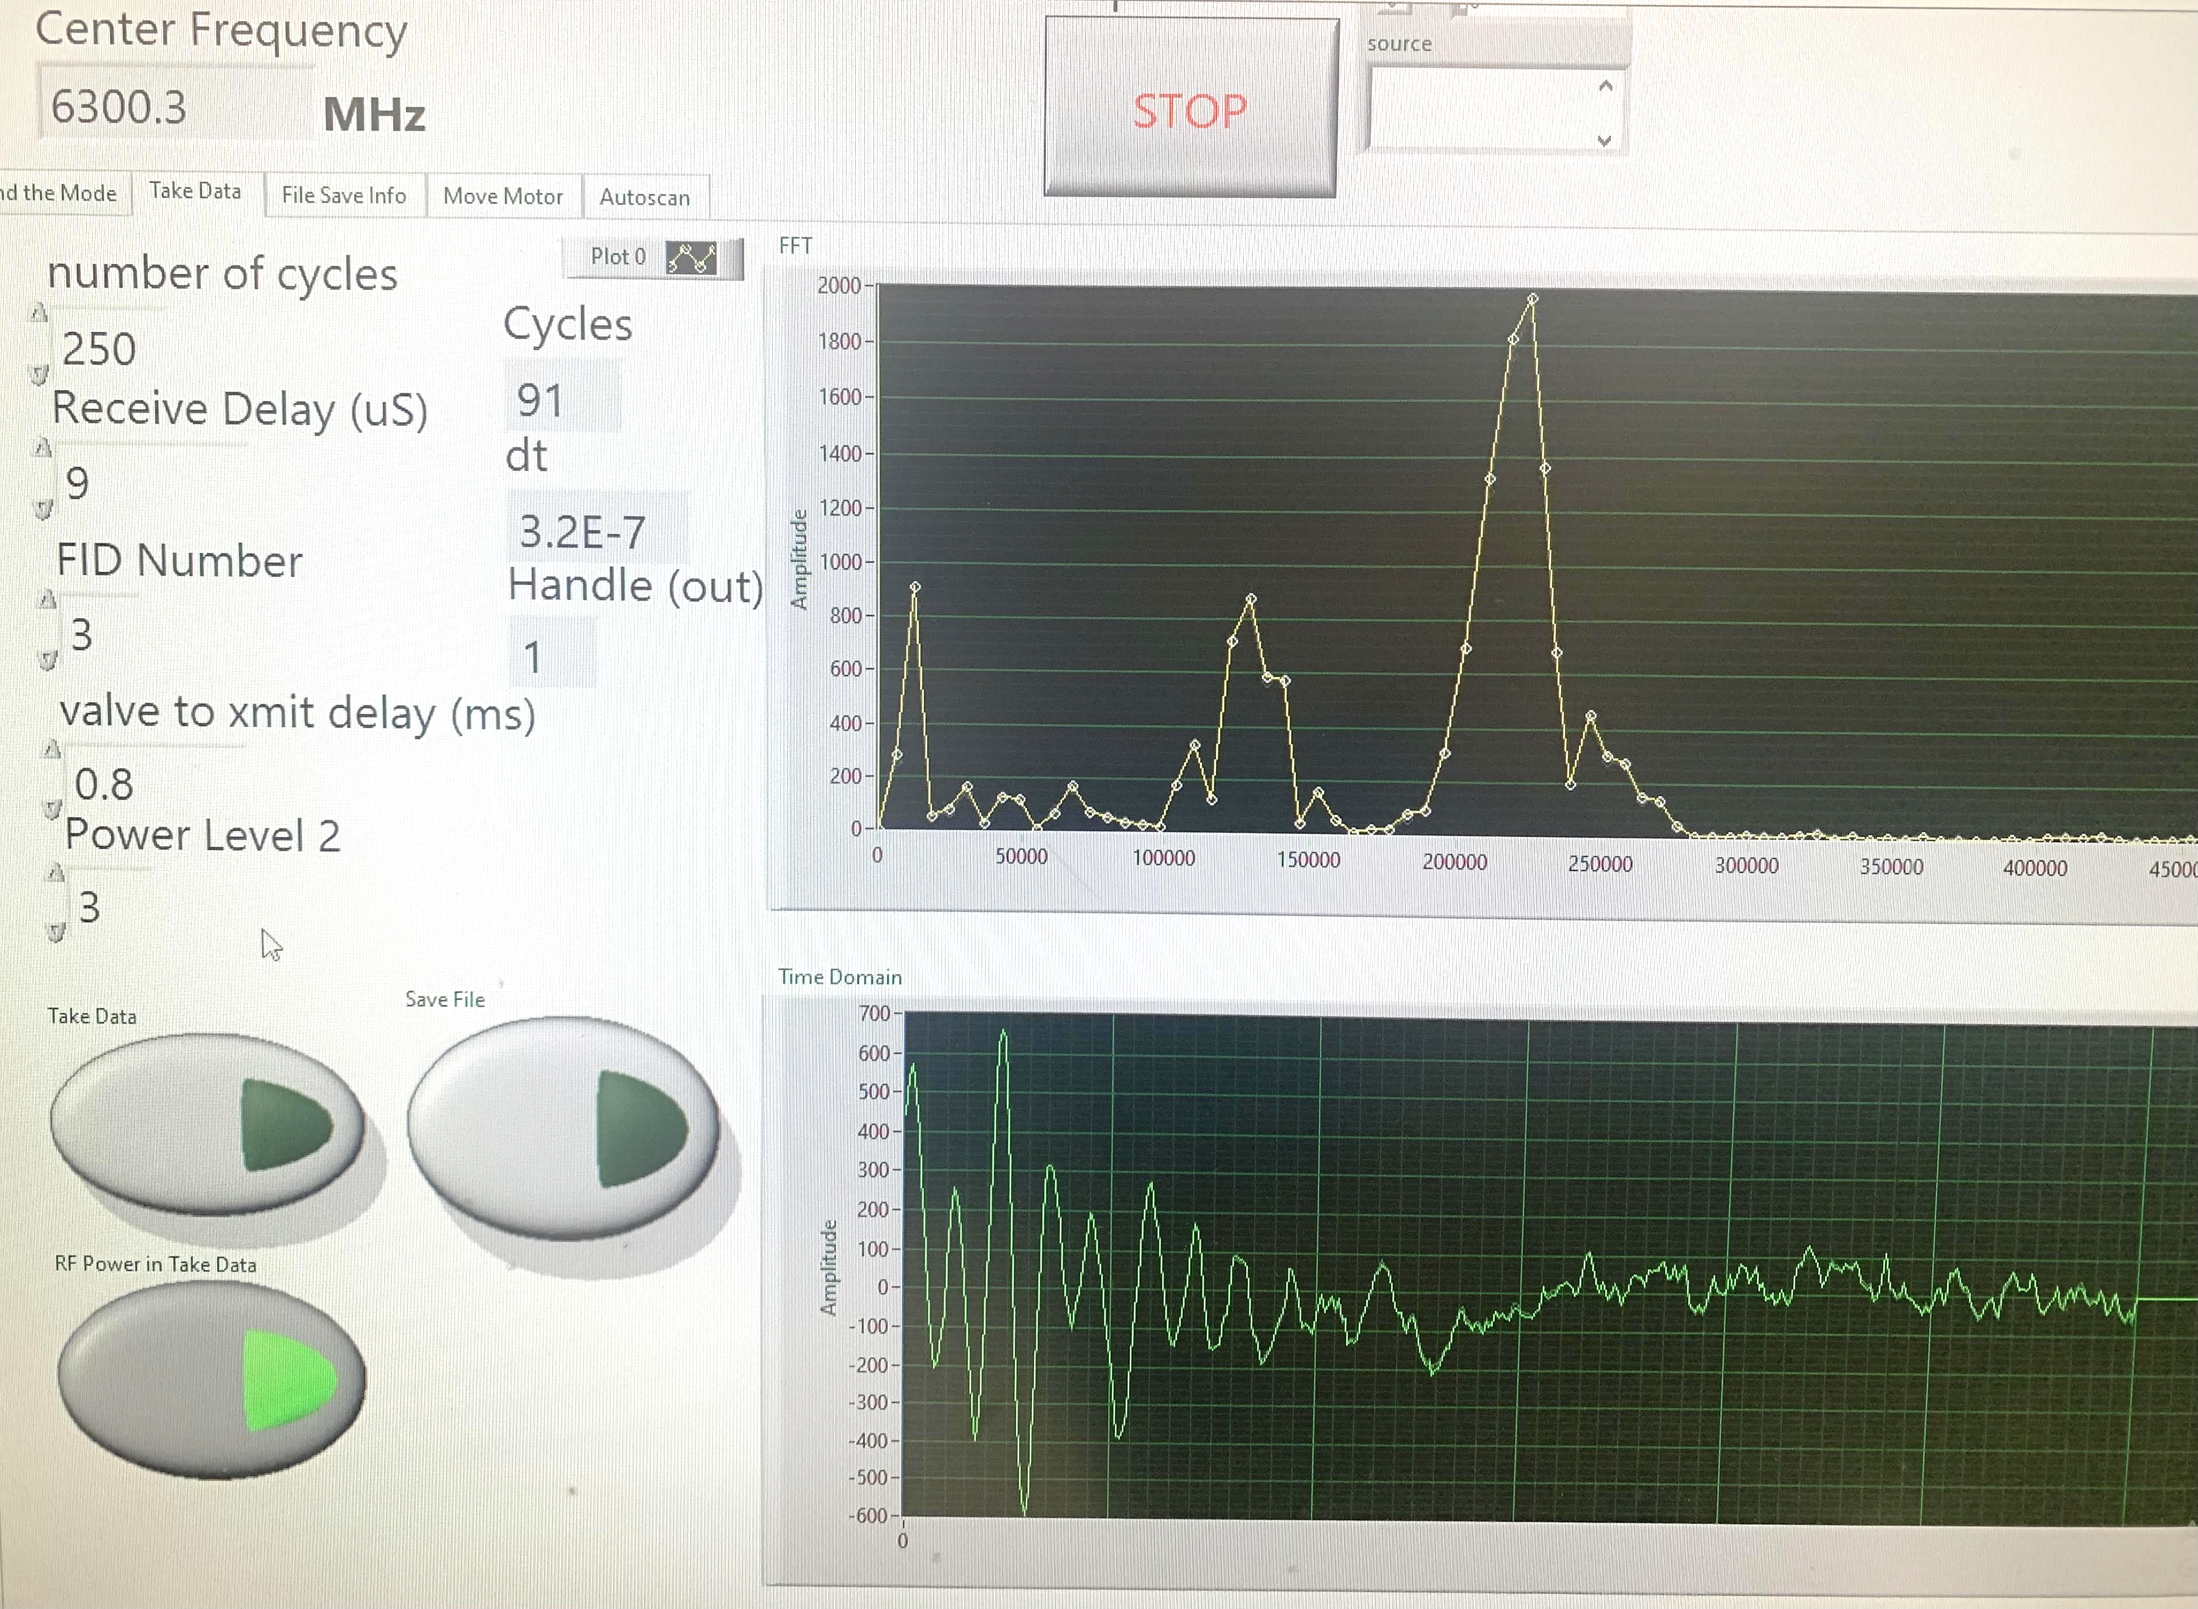
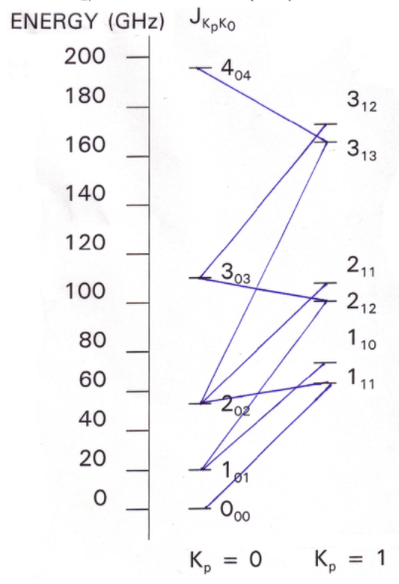
Results
We have located lines correlating to both states of the molecule
An evolving fit of the all-hydrogen sample
Provides experimental A, B, and C rotational constants, as well as quadrupole constants
Measured 0→1 transition for fully deuterated sample
Source: Kukolich Group

Slide 8

Looking forward…
Line hunting! Better fits lead to refined predictions
Find higher level transitions of fully deuterated sample
Potentially study partially deuterated samples as well
Use experimental structure to find energy barrier to tunneling using a method called double resonance
Source: clipartkid.com

Slide 9
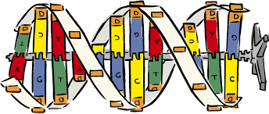
Conclusions
These results will help scientists better understand the chemical interactions occurring in DNA
This base pair interaction is thought to be responsible for some genetic mutations
From this project, I’ve taken away the skills needed to…
Perform quantum calculations
Find lines experimentally with microwave spectrometer
Fit the measured lines by adjusting rotational constants for best fit
Program in MatLab to view large scans
Source: clipart-library.com

Slide 10
Acknowledgements
Special thank you to my mentors, Dr. Stephen Kukolich and Dr. Adam Daly
Arizona NASA Space Grant Consortium for funding my research
University of Arizona Department of Chemistry and Biochemistry

Slide 11
Thank You

